Slide 1
National Scrapbook Day 2021
Event Success Guide

Slide 2
What are National Scrapbook Day events? Incredibly fun, Advisor-held, Home Office-supported customer crops. Each year, Creative Memories releases ideas and products available exclusively to Advisors to help with their National Scrapbook Day customer events (March-May). These events come in all sizes from small, in-home events with a few friends to large, conference room crops with hundreds.
Our NSD 2021 Event Success Guide offers you a stack of tips to plan and have the best event ever! You can follow the complete guide or select the tips that suit your goals and help your customers enjoy an amazing memory-keeping event with you!
This guide complements the NSD Advisor Guide Resources found here: https://love.creativememories.com/nsd-2021-advisor-guide-us/
Find your COVID-19 Event Precautions here: https://love.creativememories.com/general-event-support/

Slide 3
HOW TO USE THIS GUIDE
Use the Event Planning Checklist on the next page, noting dates to complete tasks in your diary/calendar.
Work through each page of this guide, filling in the planning questions as you go.
Use the other flyers, templates and printable resources available to you on the 2021 NSD Advisor page (you’ll find the link in the Advisor HQ).

Slide 4
You may choose to hold one event or several events during March, April and May.
NSD event suggestions include: virtual event (see Virtual NSD Event Guide),10-hour crop, 12-hour crop, two-day crop (guests attend one or two days), weekend retreat.
My event type/duration: _________________________________
My event date(s): _______________________________________
Don’t forget to submit your events so that they appear on the Creative Memories website! Click the link below to learn how to submit your events!
https://creativememories.wistia.com/medias/2sn5p7ang5

Slide 5
EVENT PLANNING CHECKLIST
1 week before:
❏ Create registration list.
❏ Finalize your product display (printables provided).
❏ Plan your table settings and giveaways.
The week of:
❏ Pack for your event about two days before.
❏ Follow up with the venue and make sure all is as agreed.
6 weeks before:
❏ Set the date and venue.
❏ Get familiar with NSD products.
❏ Set the registration fee.
❏ Set your event theme.
❏ Write your guest list.
❏ Create and send your invitations.
3-4 weeks before:
❏ Collect pre-orders.
❏ Order products for your event.
❏ Confirm attendance (confirmation letter provided).
2 weeks before:
❏ Create your event schedule (sample agenda provided).
❏ Set your event goals.

Slide 6
RESOURCES TO USE
The following resources are available to download for FREE on the NSD Event page: https://love.creativememories.com/nsd-2021-advisor-guide-us/
❏ Printable materials
❏ Confirmation letter template
❏ Sample agenda templates
❏ Event goal sheet
Other resources available in the Advisor HQ or Advisor Exclusives section:
❏ Current catalogs
❏ Customer order forms
❏ Customer wish lists

Slide 7
CHOOSING A VENUE
Your venue needs depend on the number of guests anticipated at your event.
Estimated number of event guests:__________________
Do you need the venue to have:
❏ Tables and chairs
❏ Catering or kitchen
❏ Heating/cooling
❏ Parking
❏ Accommodations
❏ Masks - purchase yours from CM https://www.creativememories.com/disposable-non-surgical-face-masks.html
❏ COVID-19 SAFETY CONSIDERATIONS https://love.creativememories.com/general-event-support/

Slide 8
SET YOUR REGISTRATION FEE
Add your event costs and divide by the number of estimated guests:
$_______
Venue rent
+
+
$_______
Project Recipe™ Kits
+
$_______
Gifts/prizes
=
$_______
Total
$_______
Food/catering
$_______ / #________ = $_______
Total / Number of guests = Registration fee per person
Your time is valuable, too! We recommend you add a cost for your time for organizing and running the event.

Slide 9
SET YOUR REGISTRATION FEE
Add your event costs and divide by the number of estimated guests:
CATERING: You may wish to cater your own food to keep costs lower. E.g., lunch is $10.00 each with coffee/tea included. Add $5.00 each for snacks/chocolate at each place setting = $15.00 per person for food.
ADVISOR EXCLUSIVES: Recommended budget of $2.50-12.50 per guest to add to the place setting with the Project Recipe™ Kit. Log in to the website and select the NSD gifts.
PRIZES: Recommended budget approximately $5 per person for prizes.

Slide 10
NSD PRODUCTS
View the National Scrapbook Day Advisor Guide page for more product details. https://love.creativememories.com/nsd-2021-advisor-guide-us/
Product Tips:
Include the cost of the kit in your event registration fee or have customers pre-order the kit for delivery at the event.
Project Recipe™ Kits save you time/energy/effort. Simply purchase the kits and hand them out on the day.
Complete your own Project Recipe™ Kit before your event for display and so you can instruct/help guests complete theirs.
Offer products from the NSD What’s New Flyer for customers to customize their Project Recipe™ layouts.

Slide 11
NSD PRODUCTS
View the National Scrapbook Day Advisor Guide page for more product details. https://love.creativememories.com/nsd-2021-advisor-guide-us/
Product Tips:
Use the NSD album cover as your major prize for the day (earn tickets to be entered in the drawing).
Take pre-orders for the sale of the album cover, and all who pre-order will be entered into a draw to win White Refill Pages.
Offer a personal special on the album cover. (E.g., buy the album cover and get $X off a future purchase.)

Slide 12
NSD PRODUCTS
View the National Scrapbook Day Advisor Guide page for more product details. https://love.creativememories.com/nsd-2021-advisor-guide-us/
Product Tips:
If you host a Paper Buffet™, offer cardstock shades individually during the buffet.
Sell these cardstock packs exclusively at your event.
Provide one sheet per guest as an attendance gift.

Slide 13
NSD PRODUCTS
View the National Scrapbook Day Advisor Guide page for more product details.
https://love.creativememories.com/nsd-2021-advisor-guide-us/
Product Tips:
Use Advisor Exclusive products as customer gifts for early registration, pre-orders, bringing a friend, ordering $80 or more at your event, booking into a future event, etc.
Create your own ideas sheet featuring these embellishments as an extra bonus for customers who do more than one of the above.

Slide 14
CHOOSE YOUR EVENT THEME
Choosing an event theme is completely optional. If you do choose a theme, it can be as creative or as simple as you wish.
Use NSD printable materials available to help theme your event at a low cost. Decorate your event with items like tablecloths, artificial flowers and more in the NSD palette.
Check out Pinterest for theme, food and decor ideas.

Slide 15
CHOOSE YOUR EVENT THEME
Tips:
While your theme can make events more memorable and fun for your guests, it’s not the most important element of your event. If you don’t have the budget or the time to theme your event, that’s okay.
Balance your planning activities to ensure success. Your main focus will be inviting guests and collecting pre-orders, delivering the Project Recipe™ and post-event customer care.

Slide 16
WRITE YOUR GUEST LIST
Fill in the names of all the people you’ll invite to your event below (copy this page if necessary). Also invite people who are not your current customers but have photos they need to print and document. As a rule of thumb, approximately one-third of the people you invite will attend your event.
________________
______________________________________________________________________________________________________________________________________________
___________________
___________________
___________________
___________________
___________________
___________________
___________________
___________________
___________________
______________________________________________________________________________________________________________________________

Slide 17
CREATE & SEND YOUR INVITES
Set the early-bird RSVP date: ____________
(Offer a discount or a small gift to create urgency.)
Set the final RSVP date: _____________
Tips:
Print invites as photos or on 4x6 cards.
One each for current customers.
Extras to share with new people and for customers to share with friends.
Use the email banner provided to promote your event in your own customer email newsletters.
Offer an early-bird special to register four (4) weeks prior to the event (helps you with planning).
Offer a pre-order gift or free shipping if pre-orders are received four (4) weeks prior the to event.

Slide 18
PROMOTE YOUR EVENT
You’ve created your invitation — now promote your event! You’ll want to share your event with your existing customer base, friends and family. You’ll also want to share it beyond your current network.
Share your invitation on social media channels: Facebook, Instagram, Twitter, Snapchat, etc.
Encourage friends to share the invitation on their social media channels.
Seek out relevant Facebook groups to share your event details: Mothers groups, Photo groups, History groups and more.
Create a Facebook event to promote and collect RSVPs.
Make calls — they make a huge difference in contacting those who may be too busy to see an email or Facebook message.
Promote it in person by carrying invites and sharing them.
Place an event poster on your workplace lunchroom notice board or ask family and friends to put up a poster at their workplace.
Offer a gift to current customers who bring a friend.
5 WAYS I’LL PROMOTE MY EVENT:
______________________________
______________________________
______________________________
______________________________
______________________________
______________________________

Slide 19
CONFIRM REGISTRATIONS & PREORDERS
Follow up each registration with a customer-care call with an aim to collect pre-orders. Collecting orders before your event helps your customers get the products they need to work on their projects and helps you grow your Account Balance for higher earnings.
Set your pre-order deadline date: ____________
Tips:
Download the NSD What’s New Flyer to talk through the coordinating products that complement the Project Recipe™.
Suggest an offer to encourage pre-orders by your deadline date: Free shipping or an extra customer gift (e.g., NSD Gift Embellishments).
Questions to ask:
What projects do you want to complete at the event?
I’d love to help you prepare your photos. When could I visit you?
I just got my new order. Would you like to see the newest products?
Are you in need of some basic supplies before the event?

Slide 20
PRODUCT AT YOUR EVENT
To increase your event profitability, you’ll want to have some basic supplies on hand to support your guests’ project creation at your event. Consider some of these basics and write a list of the products you’ll order to sell at your event.
SUGGESTED PRODUCT TO SELL:
Tape Runner Refills (all types)
Precision Point Adhesive Pen
Foam Squares
White Refill Pages
12-inch Trimmer Replacement Blades
Download the NSD What’s New Flyer and aim to have some of these products on hand to support customers’ project creation.
PRODUCT I’LL SELL AT MY EVENT:
___________________________
___________________________ ___________________________ ___________________________ ___________________________ ___________________________

Slide 21
PRODUCT AT YOUR EVENT
The adage is true: You sell what you show. In addition to the basic supplies to sell at your event, a page layout/ideas using the newest products could inspire customers to place a new order with you for delivery at your next event.
PRODUCT DISPLAY:
Create the Project Recipe™ Kit layouts to include in your display.
Start with what you can afford, such as a page layout display featuring our newest products.
Open and display products from the newest large collection.
If you can afford a larger display, cover the big four themes of baby, wedding, travel and school.
Display the Original Border Maker System and Border Maker Cartridges with border samples on a poster.
Have a tools station for customers to try out your most current tools and be inspired to buy their own.

Slide 22
CONFIRM ATTENDANCE LETTER
A few weeks before your event, send an attendance confirmation letter to any customers who’ve registered. You can send your letter via email or regular mail.
Use the sample Attendance Confirmation Letter provided.
Add your name.
Add the customer’s name.
Update the pre-order and event dates.
Choose your country catalog link and delete the others.
Make a quick follow-up call to anyone who hasn’t placed a pre-order to ensure they received and read the letter, answer any questions and remind them there’s still time to place an order.
WEEK OF EVENT: Send reminders and let everyone know (via email, text messages and customer Facebook groups) how excited you are to see them. Remind them to print and bring photos and supplies.

Slide 23
CREATE YOUR EVENT SCHEDULE
Whether you are holding your first NSD at home or are part of a large event at a venue, we’ve created an example schedule to help you create a fun and memorable NSD!
AT YOUR EVENT: Remember to take your own photos of guests at the event. Share some pictures on the Advisor Facebook group. You can also share pictures in your own private Facebook Group for your customers and with the guests who attended.
Download the example NSD Event Schedule provided.
Adjust the activities to suit your event.
Add the times you will offer each activity.
Print your event schedule and distribute it to any helpers and event co-hosts.
If you choose to, distribute your Event Schedule to guests also.

Slide 24
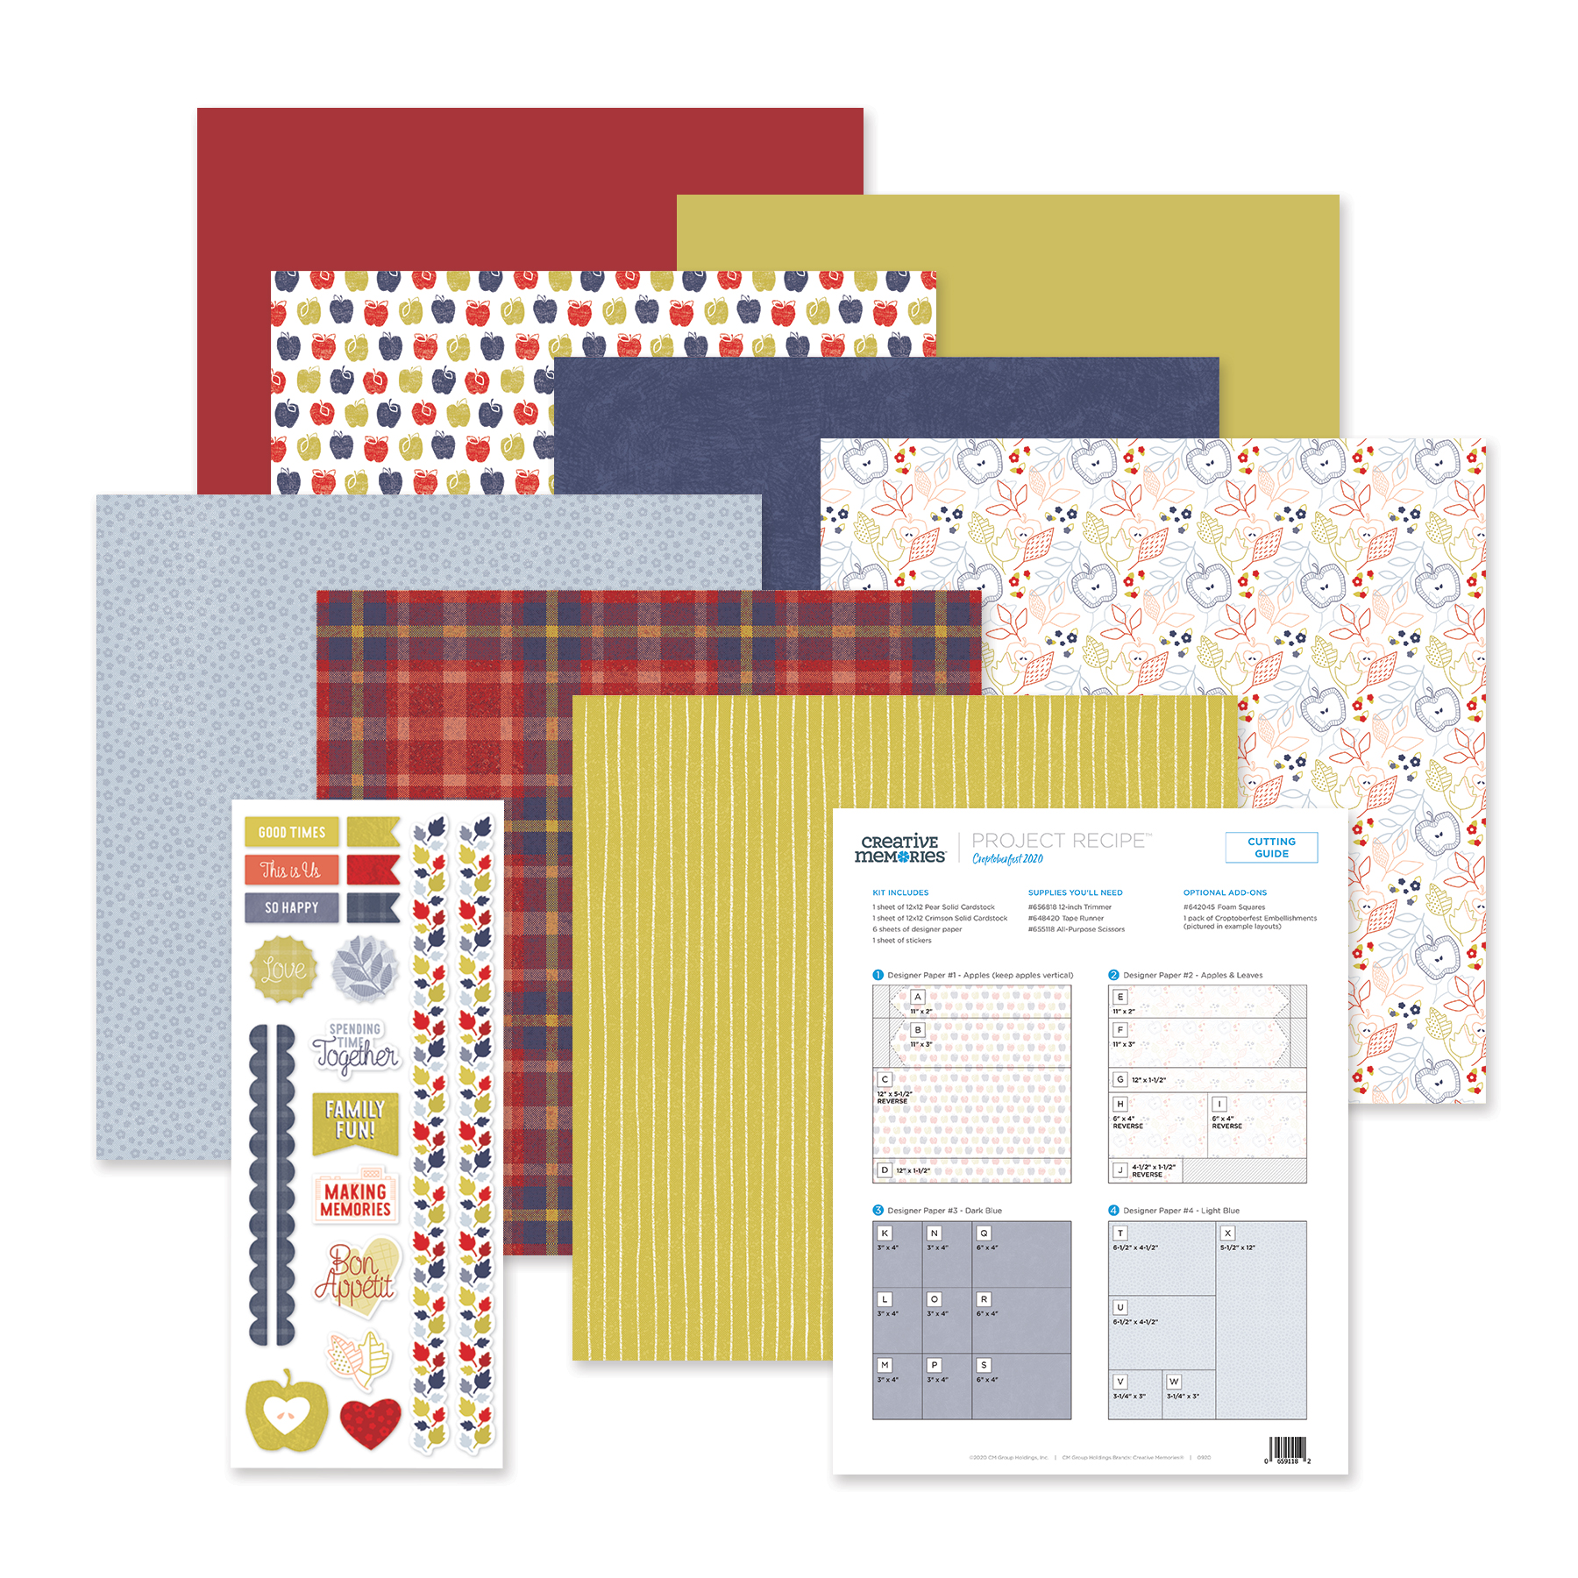
TABLE SETTINGS
SUGGESTED TABLE SETTING PER GUEST:
Agenda
Current What’s New Flyer
Current customer offer flyers
Catalog
Wish list
Order form
Upcoming workshop calendar
Project Recipe™ Kit
Registration/attendance gift
Name tag
Mask
EXTRAS:
A scrap bin per table is handy
Bottled water
Hand sanitizer
UPDATED IMAGE COMING

Slide 25
YOUR EVENT GOALS
Download the Event Goal Sheet from the National Scrapbook Day Advisor Guide page. Fill in your goals before your event and results after the event.
Tips:
Encourage pre-orders.
Encourage bookings to future events.
Set expectations of $80 per person in sales at event.
Small events: Aim for two new customers at your event.
Medium events: Aim for four new customers at your event.
Large events: Aim for six new customers at your event.
Aim to welcome at least one new Advisor to your team at your event.
Making your event more profitable:
You have a HUGE opportunity to upsell.
Consider a Paper Buffet™.
Share all current customer offers at your event.
Create your own offer or provide Gift Embellishments to reward large orders, bringing a friend or joining your team.

Slide 26
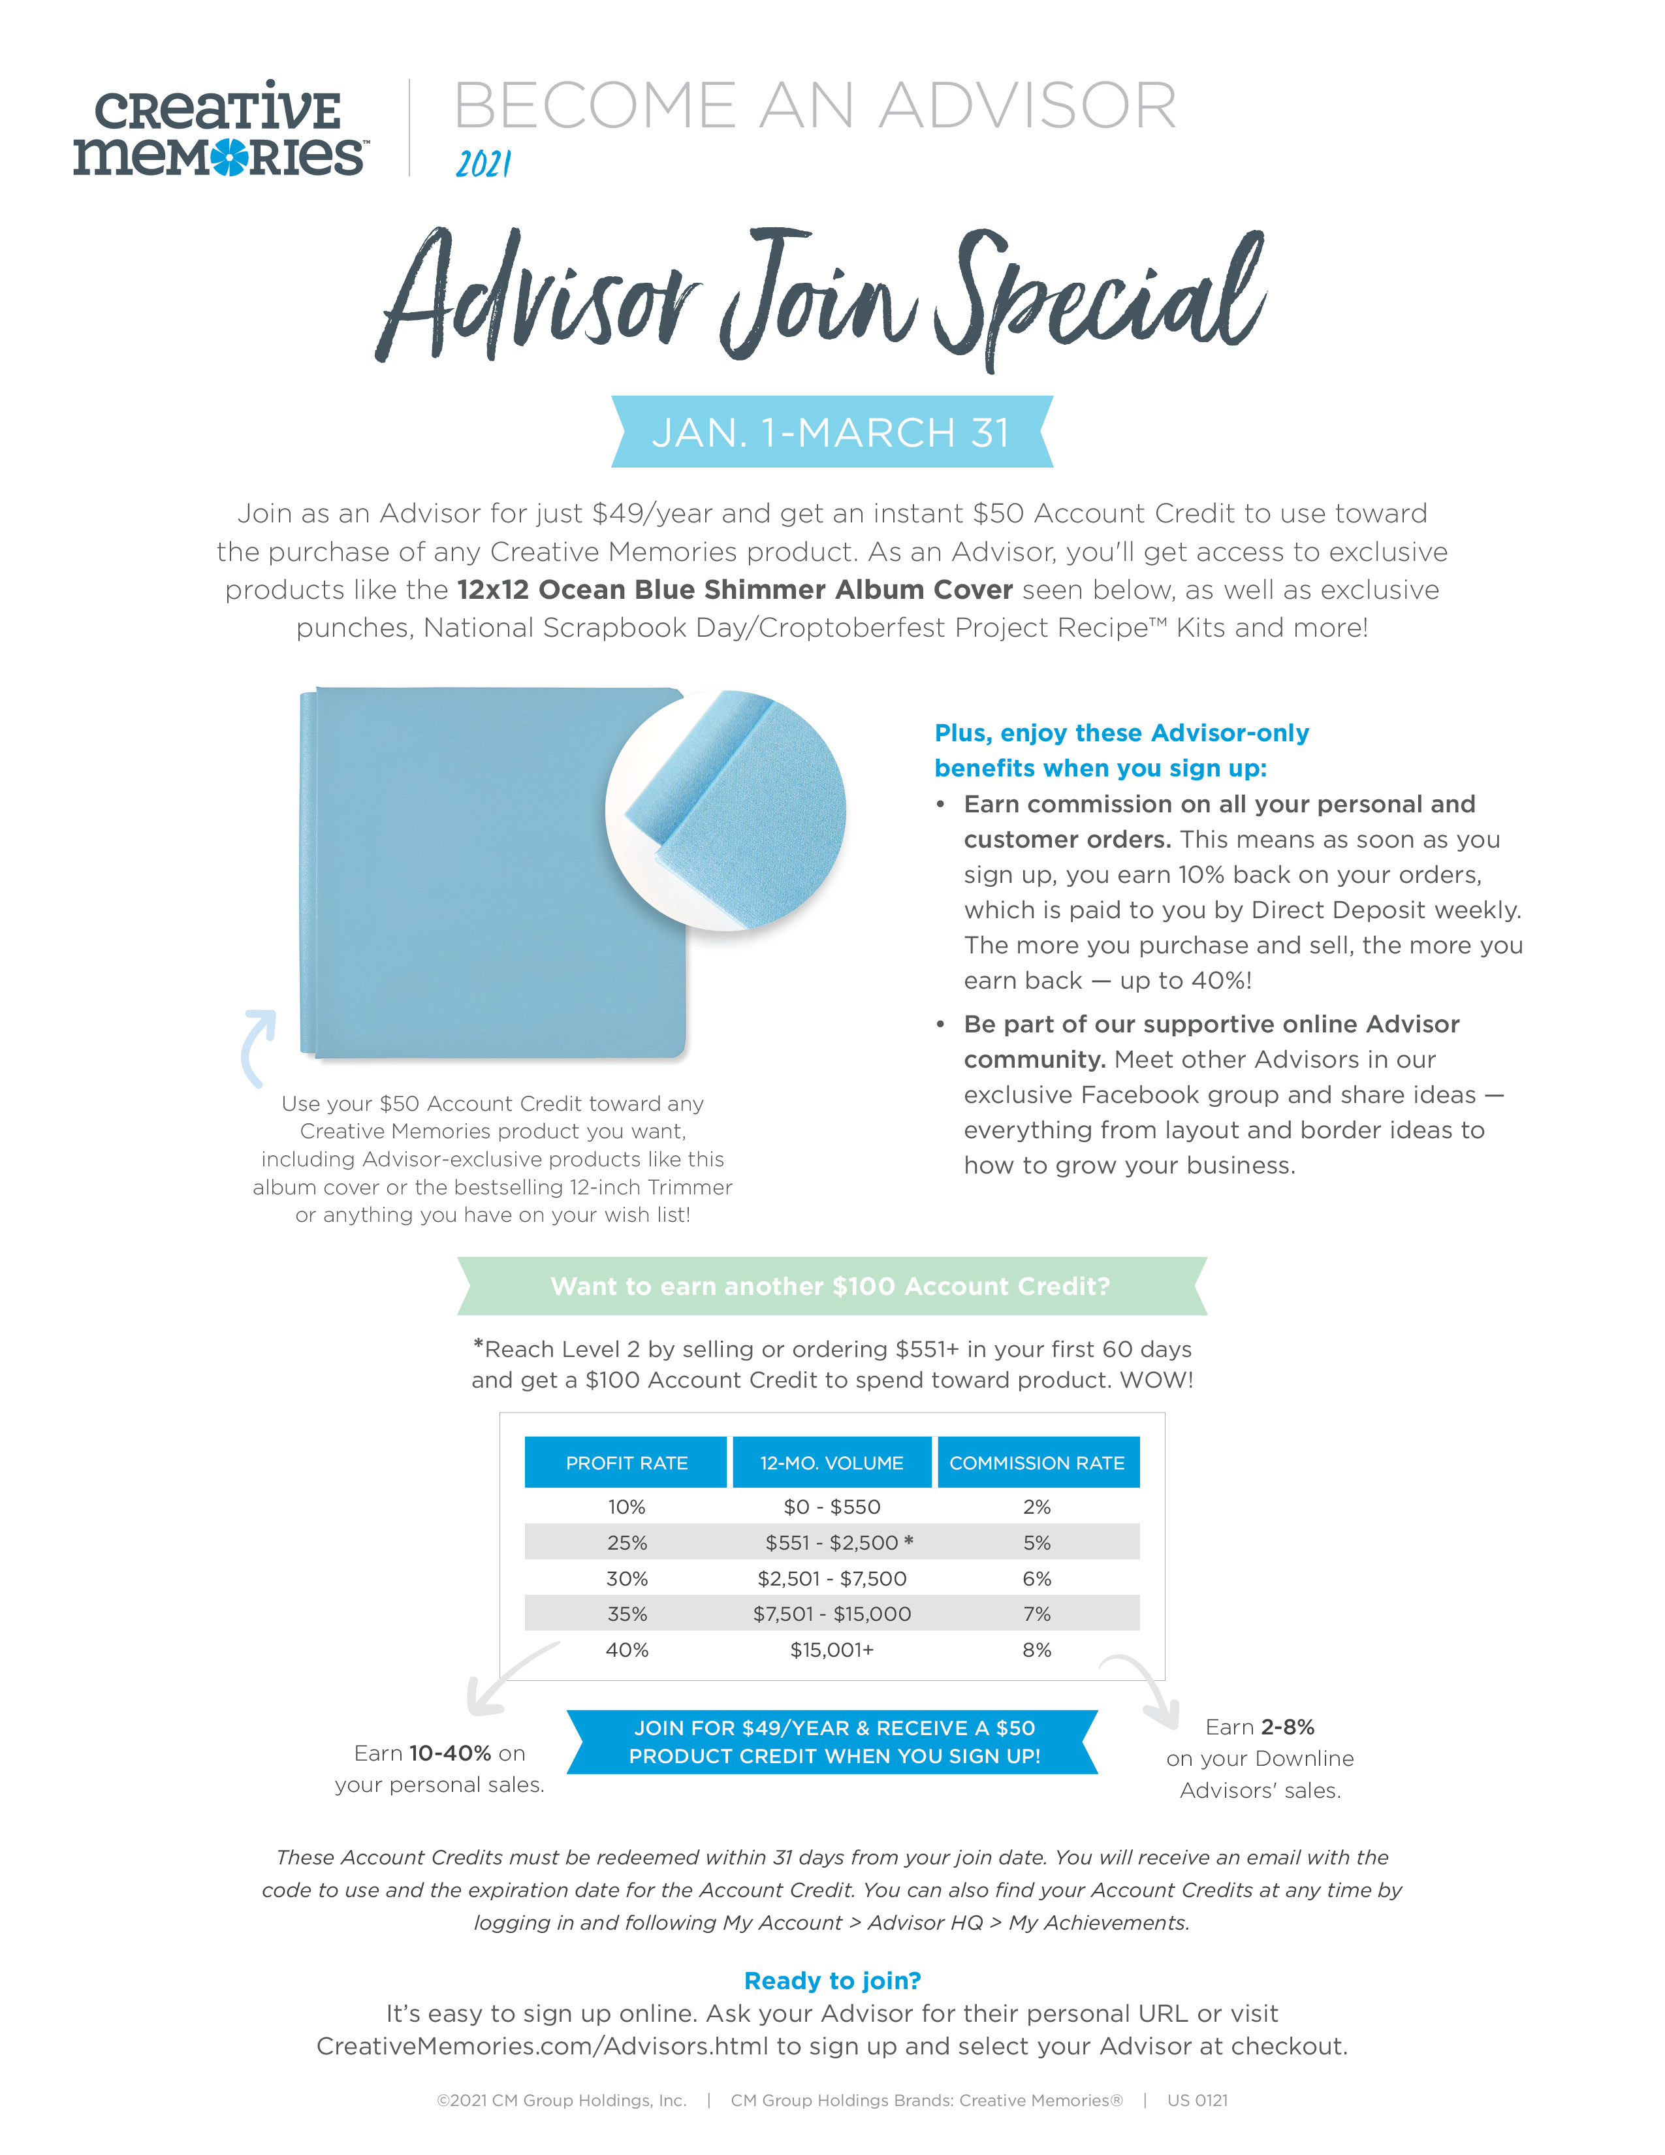
EVENT IDEA: DISPLAY ADVISOR JOIN
We recommend displaying the latest Advisor Join offer and flyer. It will really showcase the value and you never know who may be inspired to join your team!

Slide 27
EVENT IDEAS: PRIZE & RAFFLE SUGGESTIONS
OFFER RAFFLE TICKETS FOR:
1 ticket for attendance
1 ticket for early registration
1 ticket for each double-page layout completed
1 ticket for booking a Project Recipe™ event
Double tickets once they complete both Project Recipe™ layouts = 4 tickets
1 ticket for every $___ ordered today
Participate in the Paper Buffet™ for an extra ticket
Reward a customer for bringing a friend
Double tickets for joining your team
Tip: Hold your prize drawing toward the end of your event.
BONUS IDEA: Pot of Gold Raffle – It works like a sweepstakes and works best for larger events. Everyone contributes $5 and receives a ticket. At the end of the event, the total raised is drawn up into three prize categories: 1st Prize: 50% of the pool, 2nd Prize: 30% of the pool, 3rd Prize: 20% of the pool. The three winners now have the “cash prize” and this is spent with their Advisor on new product(s) of their choice. Note: It does not pay off any purchases already made on the day, but is bonus spending money.

Slide 28
OTHER EVENT IDEAS
Host a sip & sort event two or three weeks prior to your NSD event. Schedule it for two hours and display the newest products and encourage pre-orders as you sort photos.
Do a make-and-take border or card using the newest collections.
Do a “try before you buy” with the new tools — you can combine this with the make-and-take.
Host a tools technique class such as featuring the Original Border Maker System and newest cartridges.
Host a card class. Take pre-orders in advance and hold the class at some point throughout your event.
Not sure what these events are but know that you want to do something? Use the following link to schedule time to chat with Advisor Success Coach Diane Lampert! http://calendly.com/creativememories/diane

Slide 29
PACKING CHECKLIST
❏ Project Recipe™ Kits and other NSD products!
❏ Registration and customer gifts
❏ 12-inch Trimmer
❏ Tape Runners
❏ Custom Cutting System Mat and Blades
❏ Original Border Maker System with Cartridges and Border Punches
❏ Displays, including albums and border ideas
❏ Project Recipe™ samples
❏ Advisor-opportunity information for display
❏ Stock to sell and customer pre-orders
❏ Order forms, catalogs, wish lists
❏ Music — discuss options and decide on customer preferences
❏ Event registration list
❏ Future workshops booking sheet
❏ Cash to make change
❏ Tablecloths, easels
❏ Prizes, tickets, bags for tickets
❏ Table setting supplies, scissors, tape, trash bins ❏ Masks ❏ Hand sanitizer

Slide 30
You’ve Got This!
If you have any additional questions or need help planning your 2021 NSD event write to us at Coach@CreativeMemories.com!

